Slide 1
12/23/2010

Slide 2
Warm-Up: Predicting
Literature Books: pg. 80 #1-5
Only write the answers.
Ex. 1. ___
2. _____
Comp. books

Slide 3
Warm-Up: Making Inferences
Directions: Read each passage and then respond to the questions. Each question will ask you to make a logical inference based on textual details. Explain your answer by referencing the text.
Everyday after work Paul took his muddy boots off on the steps of the front porch. Alice would have a fit if the boots made it so far as the welcome mat. He then took off his dusty overalls and threw them into a plastic garbage bag; Alice left a new garbage bag tied to the porch railing for him every morning. On his way in the house, he dropped the garbage bag off at the washing machine and went straight up stairs to the shower as he was instructed. He would eat dinner with her after he was “presentable,” as Alice had often said.
1. What type of job does Paul work? ____________________________________________________
^{How do you know this?}
2. Describe Alice: __________________________________________
What in the text supports your description?
3. What relationship do Paul and Alice have? ______________________________________________________
^{Why do you feel this way?}
Comp. books

Slide 4
2nd Quarter Reflection
You, the student, need to look through your classroom binder/composition book and analyze the work you have done during the semester quarter.
Write 1-2 pages of reflection, in paragraph format, using the following guidelines
1. I learn best by_____________. Therefore, when I study or do work I_____________________.
Explain study habits
2. As I look back at the work I have done in ________________________for the ______Quarter,
Subject #
I notice that________________________________________________________________________.
Whatever you have done correctly or incorrectly (study habits)
3. Something specific I should do to be successful in school and in life is____________________.
Explain in detail
4. I really enjoyed ____________________________because_____________________________.
Name the assignment or project Explain the reason/s
5. This assignment is related to _______________________because____________________.
Other Subject Areas Explain the reason/s
6. I feel that these Nine Weeks in __________________I really learned____________________,
Subject
and I will/can apply that in _____________________________________________________.
1st Grade of
the Quarter

Slide 5
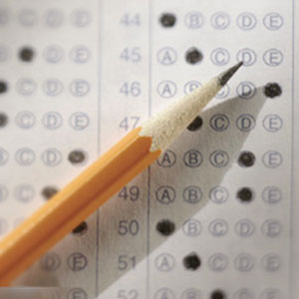
Author’s Purpose Reassessment

