Slide 1
What To Expect This Year In Language Arts
Ms. Monica Ball, Grade 6

Slide 2
WELCOME!
Welcome to an exciting new year! I am looking forward to a successful and enthusiastic year with each of you. I know that you are talented and special in your own way, and I believe in each and every one of you. This year you will be challenged to increase your skills in vocabulary, reading comprehension, writing, speaking, grammar, and team building.
We will explore a great deal of our curriculum through projects, technology, and student-driven learning in addition to our classroom assignments. We will survey several genres of literature in an effort to learn about the world in which we live.

Slide 3
What Ms. Ball Expects
At Ligon, our slog is simple: Ligon Middle School – Lead the Way. Manage Yourself. Show Respect. This slogan dictates the way students and staff are expected to conduct themselves while at school. I expect to give a lot of positive reinforcement for jobs well done. I do not expect to have to respond often to recurring negative behaviors. There are specific expectations of students entering my room.

Slide 4
Ms. Ball’s Classroom Expectations
1. RESPECT YOURSELF AND ONE ANOTHER
Take action to improve
Be thoughtful when speaking
Respect other’s property
Wear appropriate clothing
2. ROOM 2310 IS A SAFE ZONE
Ask questions, even if you think they are stupid
Act and speak with a positive attitude
3. TAKE INITIATIVE
If absent come get the missed work
Come after school or in the morning for help
Check the website or send an email
4. USE TECHNOLOGY APPROPRIATELY
Phones must be powered off and not visible
Use the internet appropriately
5. VALUE BOTH PROCESS AND PRODUCT
Follow directions the first time participate in class/group discussions
Keep your binder organized
6. BE RESPONDSIBLE
Come to class on time with materials
Have all assignments on due dates
Keep track of your belongings

Slide 5
Our Class Website
PLEASE
USE
IT!
KEEPING STUDENTS AND PARENTS INFORMED
Our class’ website is http://www.msball6.weebly.com.
CLASS WEBSITE
It is imperative that you check our website on a WEEKLY basis.
EDMODO
This year, certain class periods will also be using Edmodo (www.edmodo.com) to turn in some assignments. Please see our technology sheet for more information!

Slide 6
Homework Expectations
Expect about 30 minutes a night for Language Arts.
Assignments will be given on almost a daily basis. In order to ensure the effectiveness of our class, each student is required to complete EVERY assignment that is given, and have it ready to be evaluated at the beginning of the class period that is due. Deductions will be made from assignments that are turned in late (10 points per day).

Slide 7
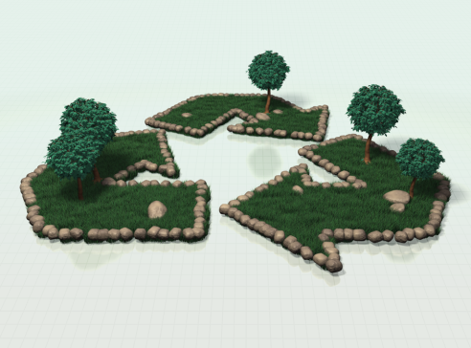

Late Work Policy (TEAM WIDE)
LATE WORK POLICY
1 Day Late= -10 points,
2 Days Late=-20 points,
3 Days Late= -30 points,
4 Days late=Not Handed In (NHI) 60%
The 6th grade team will uphold this policy and parents can monitor their student’s progress through SPAN.

Slide 8
Make-Up Work
IT IS THE STUDENT’S RESPONSIBILITY TO GET MAKE-UP WORK WHEN ABSENT
Almost every child will miss a school day at some point this school year! Due to the sheer size of the 6th grade, it is impossible for teachers to keep up with them all!
When your child misses a day they are expected to:
Go to the “While You Were Out” Binder in the back of the classroom.
Find the day(s) they were absent.
Take all worksheets and assignments in the binder.
Turn in promptly based on WCPSS make-up work policy.
Learning to Be
Responsible!

Slide 9

HOW TO HEAD YOUR ASSIGNMENTS
In order for an assignment to receive full credit the following heading must be placed in the top right or left hand corner margin of the paper above the lines:
First name, Last Name
Language Arts, ____ period
Date
Monica Ball
Language Arts, 1st period
08/25/2011

Slide 10
Grading Policy
GRADING POLICY
The grading scale for this class is as follows:
A=100-93 (Outstanding)
B= 92-85 (Very Good)
C= 84-77 (Satisfactory)
D= 76-70 (Needs Improvement)
F= Below 70 (Unsatisfactory)
You grade will be divided as follows:
10%- Homework
90%- Classwork, Quizzes, Tests, Note Checks, Presentations, Benchmarks
Make The Grade!

Slide 11

Fairness Policy
Time
Everyone is at school for the same amount of time.
Everyone is expected to invest the same amount of time in learning-in and out of school!
Fun
Everyone should have an equivalent amount of fun.
Learning
Everyone has a right to learn something new.
Challenge
Everyone deserves a challenge.
What challenges one person does not challenge all.

Slide 12

LAST BUT NOT LEAST- COMMUNICATION
I strongly encourage communication between my students, myself, and parents. The best way to reach me is via email at: mball@wcpss.net. Please know that my door is always open and I encourage you to share with me any questions, comments, ideas or concerns. I look forward to an excellent year of learning!

